Slide 1

V&V COOPANS Build 3.2 Schedule
Dan
August 2016, week 34 test COOPANS_B3_2_8_2

Slide 2
V&V COOPANS Schedule
Tirsdag
1000 – 1030 – Briefing
Welcome, DAN
Briefing, KSV
1030 – 1400 – Shadow med MM, Checkliste PCR
1400 – 1415 – Debriefing 1. pass
1415 – 1645 - Shadow med MM, Checkliste PCR
1645 – 1730 – Debriefing / OLs
Onsdag
0645– 0715 – Briefing
Welcome, DAN
Briefing, KSV
0715 – 1000 – Shadow med MM, Checklist PCR
1000 – 1015 – Debriefing 1. pass.
1015 – 1330 – Checkliste PCR, Reduced mode (MM online)
1330 – 14:15 – Debriefing / OLs

Slide 3
Participants / Roles
Abdelilah : Thales Analysis
Katrine: Operationel briefing
Sofi: DPR setup
Michael: TMCS + COOPANS Infrastructure
Allan: IRF Master
Vincent: Technial Test & Analysis
Dan: V&V Responsible, IT, Tools
Welcome to Thales FDP expert Pierre MIGNEREY on our V&V.
New Project Manager in COOPANS Simon Gerber.

Slide 4
Participant/Role List
Rols | 23-aug | 24-aug
ACC_EAST01 | - | BBB
ACC_EAST02 | LAB | EGN
ACC_EAST03 | HMU | HEE
ACC_EAST04 | PRK | HMU
ACC_EAST05 | RBN | MSK
ACC_EAST06 | RIK | RIK
ACC_WEST01 | BHB | CME
ACC_WEST02 | CME | JBI
ACC_WEST03 | PBR | NOR
APP01 | JGS | JGS
APP02 | TAG | LAC
APP03 | SVE | ANK
COIF01 | PMK | -
COIF02 | MJD | -
EKBI01 | CRK | CRK
EKRK01 | LHE | LHE
ENG_EXP01 | VMO | VMO
ENG_EXP02 | - | -
FDA01 | SPR | HEJ
FDA_COIF | - | MAM
MIL01 | - | MZA
MTA_TEK2_03 | MIH | MIH
OS_COOR | - | -
SUP_EXP | PBR | -
SYSEXP01 | KSV | KSV
SYSEXP02 | ARH | ARH
FIND DIG SELV….

Slide 5
SAP PSP Build 3.2
Står du til en L-vagt i vagtlisten så gør ingenting.
Ellers registrer selv!
Faste piloter skal selv registrere tid!
Brug PSP afhængig af NUAC/Naviair:
B3.2 – NUAC OS: D-00704-06-13-02
B3.2 – NUAC ATCC: D-00804-06-13-02
B3.2 – NUAC NOCP: D-00904-06-13-02
B3.2 – Naviair: B-00630-01

Slide 6

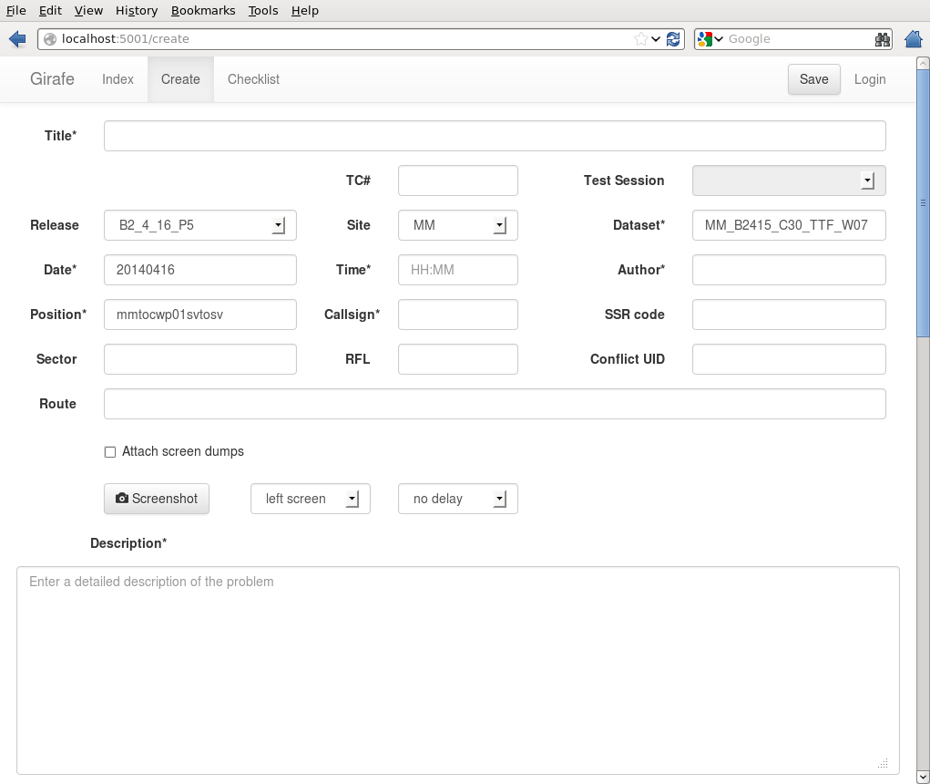
IRF writing
B3_2_7_2
B3_2_8_2
TTF_B3_2_8_2W34

Slide 7
IRF writing
ØV - TITLER !!!!!
No coupling
SAS1282
sas737
osv…
YES – TITLER
Graphical VIEW in CARD not the same on the ONL
sas1246 not able to Coord IN
Autoassumed from MM?? SAS984
Fejl i sektorrækkefølge
STCA? RYR21SR and SAS1872

Slide 8
IRF writing
XXX
Start her!
B3_2_7_2
CWP Picture
Husk at vælge rigtige skærm!
En god beskrivelse der fanger læseren

Slide 9
Purpose
Shadow
Dataset / TTF
Corrected PCRs
- WAM / + Mode S
F15
F18
CPDLC freetekst & Menues
More REV route

Slide 10
Telefonnumre
MM / Max: 0046 721-465083
MM / Stefan S: 0046 406-132260
MM / Vidar: 0046 761-935353
4/5 + GG : +46 (0)40 6131734
K/L: 31733
8/9: 31735
2/3: 31736
FDO: 31756
Det er skrevet på tavlen
CH / KSV: 0045 32478022
CH / COOPANS2: 0045 32478759

